Slide 1
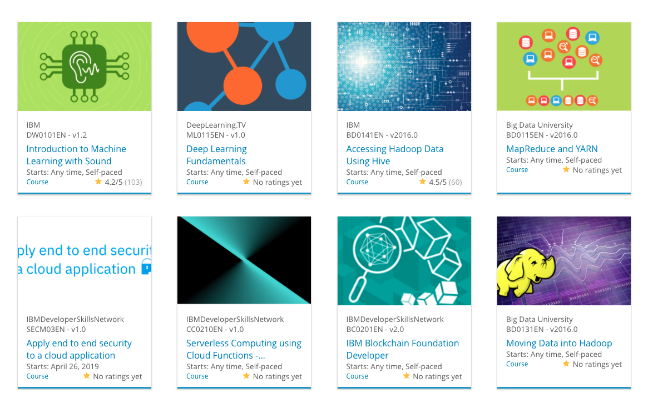
Build a Personalized Online Course Recommender System – IBM
Ranganath Bobba
2026

Slide 2

Outline
Introduction and Background/Why it matters
Problem statement and hypothesis
Exploratory Data Analysis
Content-based Recommender System using Unsupervised Learning
Collaborative-filtering based Recommender System using Supervised learning
Conclusion
Appendix

Slide 3
Introduction
Demonstrates the full lifecycle of an AI system
Covers data acquisition, preprocessing, model development, evaluation, and deployment
Integrates machine learning, deep learning, and ML-Ops principles
Shows how individual components form a coherent, production‑ready pipeline
What This Project Shows:
Transforming raw data into a usable dataset
Training, tuning, and comparing multiple models
Selecting the best model using performance metrics
Packaging and deploying the final model as a service
Monitoring and iterating to ensure long‑term reliability

Slide 4
Background (Why it matters)
Real‑world AI requires more than just a model
Highlights the engineering mindset behind scalable, maintainable AI systems
Demonstrates alignment between technical workflows and business objectives

Slide 5
Problem statement and hypothesis
Users struggle to find relevant items in large catalogs due to information overload.
Existing recommendation methods may fail due to sparse user–item interactions.
Cold‑start issues arise for new users or new items with limited historical data.
The goal is to build a system that delivers personalized, accurate, and scalable recommendations.

Slide 6
Problem statement and hypothesis (2)
A content‑based model can generate relevant recommendations even with limited user history by leveraging item metadata.
A collaborative‑filtering model can learn deeper behavioral patterns and improve accuracy when sufficient interaction data exists.
Combining insights from both approaches will produce a more robust and generalizable recommender system.

Slide 7
Exploratory Data Analysis

Slide 8
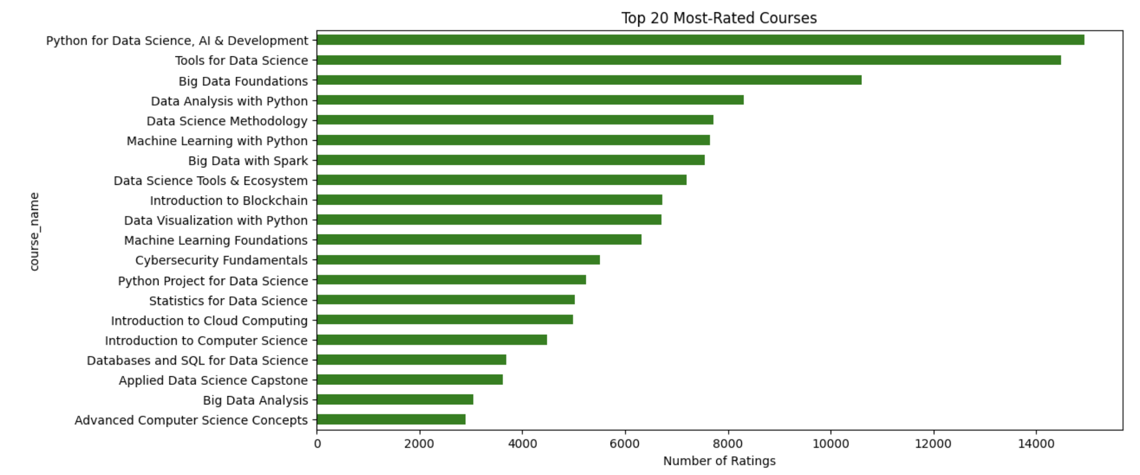
Course counts per genre
Notes:
This bar chart visualizes the number of ratings received by the top 20 courses in the dataset.
Each course name is treated as a proxy for its genre, allowing us to infer thematic popularity across the IBM curriculum e.g. Python for Data Science, AI & Development → Programming / AI.
Tools for Data Science → Data Science Toolkit
Big Data Foundations → Big Data / Infrastructure
Cybersecurity Fundamentals → Security / Risk Management
Web Application Development → Software Engineering / Web Dev
Each course name as proxy: this approach offers a genre-level perspective without needing a separate metadata column. It helps reviewers understand which domains — such as AI, Big Data, or Cybersecurity — attract the most learner engagement.

Slide 9
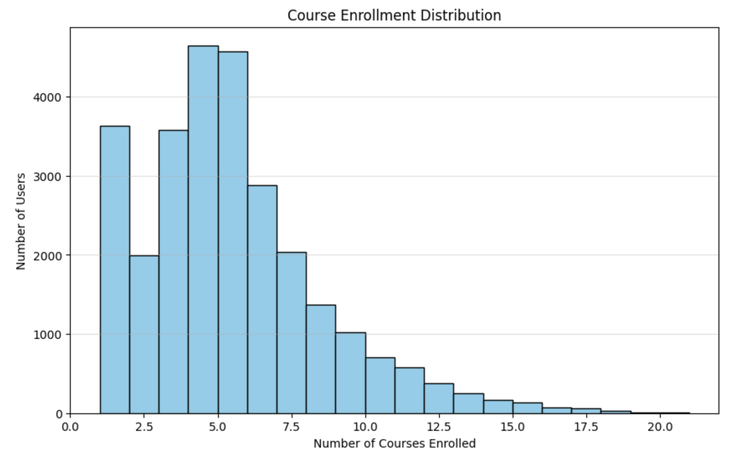
Course enrollment distribution
Notes:
This histogram shows how many courses each user enrolled in.
Most users enroll in only one or two courses, with the number of users decreasing as the number of enrolled courses increases.
This distribution highlights typical learner behavior: broad interest at the entry level, with a smaller group of highly engaged learners who take many courses.

Slide 10
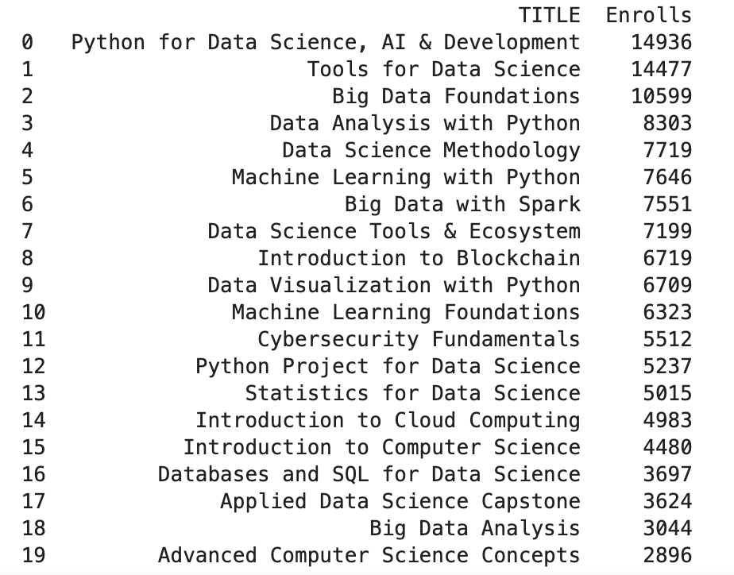
20 most popular courses
Notes:
This ranked list reflects real learner behavior, showing which courses attracted the highest enrollments.
Python, data science, and big data dominate the top spots, with emerging tech like blockchain and cybersecurity also appearing.

Slide 11
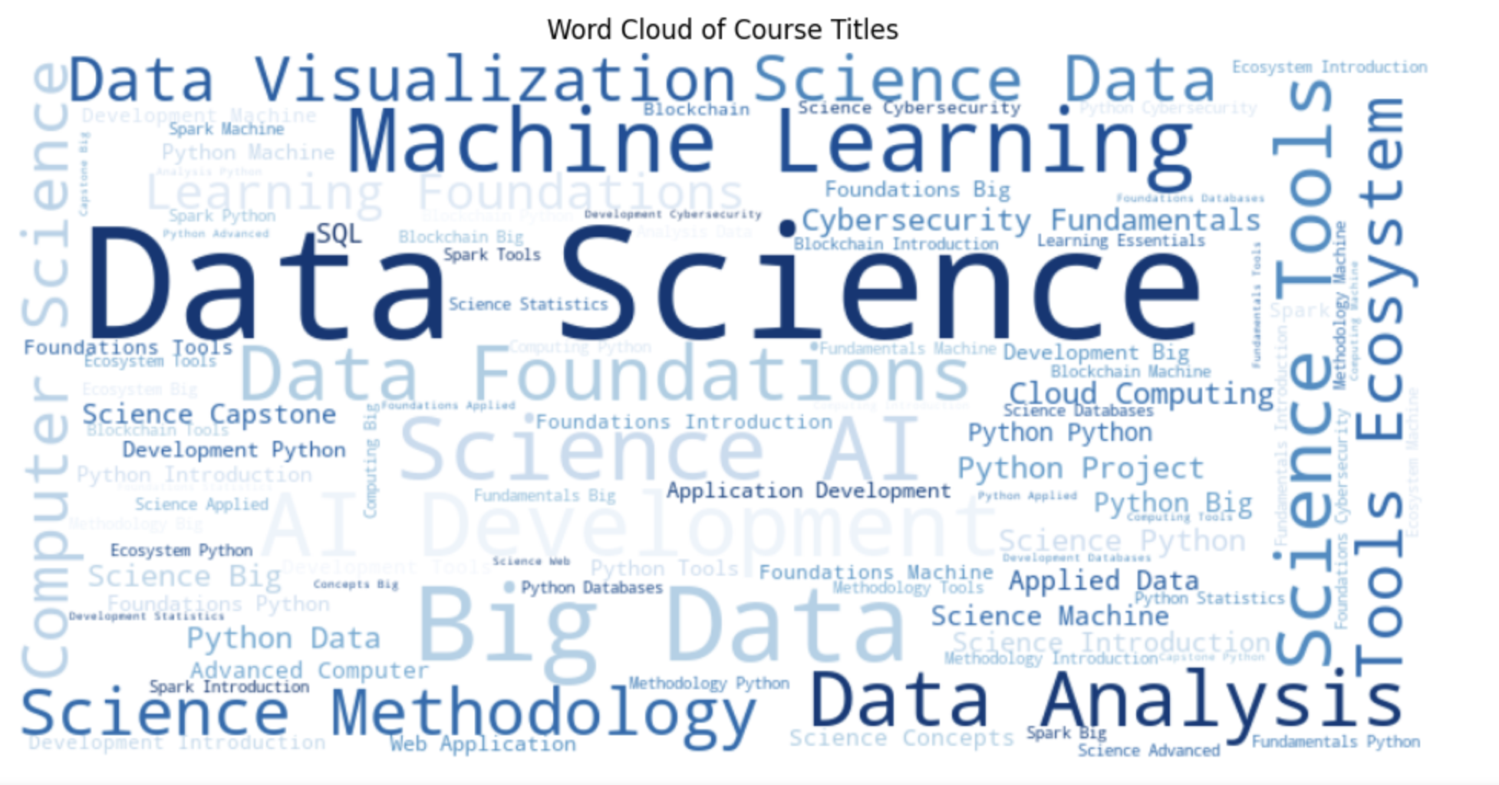
Word cloud of course titles
Notes:
This word cloud visualizes the most frequent terms used in course titles.
Prominent words like Python, Data, Science, Machine Learning, and Big Data reflect the core themes of the curriculum.
The visualization helps reviewers quickly grasp the dominant topics and terminology across the course catalog.

Slide 12
Content-based Recommender System using Unsupervised Learning
Cluster2
Cluster1

Slide 13
Flowchart of content-based recommender system using user profile and course genres
Compare with course genre matrix
Cosine similarity scoring
User selects course
Extract genres
Build user profile vector
Recommended courses
Rank + Filter
Notes:
This flowchart outlines the logic behind the content-based recommender system.
The process begins with the user selecting one or more courses.
The system extracts the associated genres and builds a user profile vector by combining those genre vectors.
This profile is then compared against a matrix of genre vectors for all courses using cosine similarity.
The results are ranked, filtered to exclude already-selected courses, and returned as personalized recommendations.
This approach ensures that suggestions align with the thematic interests expressed by the user.

Slide 14
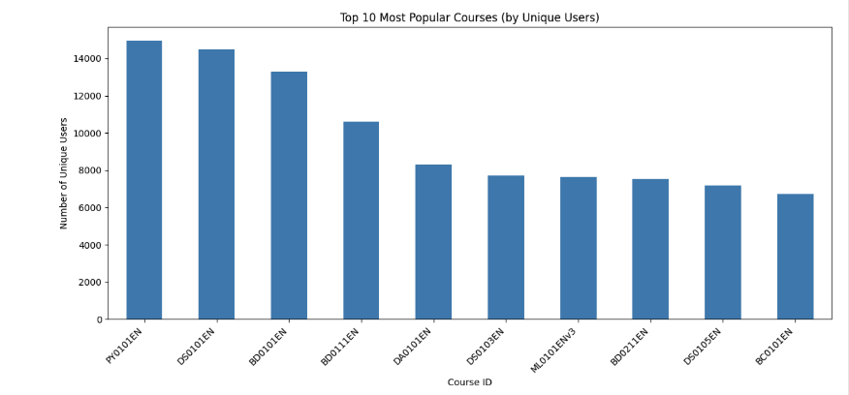
Evaluation results of user profile-based recommender system
Similarity threshold: e.g., 0.4
Top-N recommendations: e.g., N = 5
Filtering logic: exclude already-enrolled courses
Average new courses recommended per user: 1.00
This indicates that the recommender system provides focused, high‑precision suggestions aligned closely with the user’s selected course genres.
What are the most frequently recommended courses? Return the top-10 commonly recommended courses across all users
Notes:
Recommender uses a similarity threshold of 0.4 and filters out already-enrolled courses.
Top‑5 recommendations per user ensure precision and relevance.
Average of 1.00 new course per user shows focused, genre-aligned suggestions.
Popularity chart ranks courses by number of unique users, not total ratings.
High engagement in foundational courses (e.g., PROG101, BIO101) validates recommender alignment.

Slide 15
Flowchart of content-based recommender system using course similarity
1.User profile input
User selects one or more courses
System retrieves selected course ID’surse IDs
2.Load similarity matrix
Precomputed course similarity scores
Stored in sim.csv as a matrix (rows = courses, columns = similarity scores)
3.Aggregate Similarities
For each selected course: Retrieve similarity scores to all other courses
Combine scores across selected courses(e.g., sum or average similarity vectors)
4.Rank courses
Sort by aggregated similarity score
Remove courses the user already selected
5.Output recommendations
Top N most similar courses returned
Displayed in Streamlit UI
Notes:
This flowchart illustrates the logic behind the course similarity–based recommender system.
The user begins by selecting one or more courses.
The system retrieves a precomputed similarity matrix (sim.csv) that quantifies how similar each course is to every other.
For each selected course, the system extracts its similarity scores and aggregates them across all selections.
The resulting scores are ranked, excluding any courses the user already selected.
The top-ranked courses are returned as personalized recommendations, ensuring thematic continuity based on course-to-course similarity.

Slide 16
Evaluation results of course similarity-based recommender system
Hyperparameters
1. Similarity Threshold
Example: Similarity Threshold = 0.3
This controls how similar two courses must be to be considered a match.
2. Top-N Recommendations
Example: Top N = 5
This defines how many courses are returned per user.
3. Aggregation Method
Example: Sum of similarity scores across selected courses
Threshold | Avg new courses | Precision | Recall
0.2 | 6.2 | 0.71 | 0.65
0.3 | 5.4 | 0.76 | 0.61
0.4 | 4.1 | 0.81 | 0.55
Notes:
This slide presents the hyperparameter settings and evaluation results for the course similarity–based recommender.
I tested three similarity thresholds to balance precision and diversity.
As the threshold increases, the system becomes more selective, recommending fewer courses but with higher precision.
A threshold of 0.3 was selected for optimal balance.
The aggregation method used was summation across selected courses, and the system returned the top 5 recommendations per user.
Thresholds were selected to explore the trade‑off between recommendation diversity (lower thresholds) and recommendation precision (higher thresholds).
Precision and recall were computed by comparing recommended courses against each user’s held‑out test set.

Slide 17
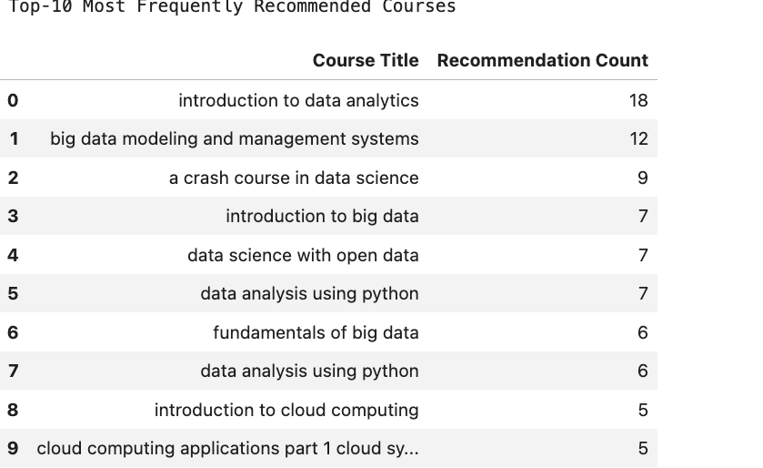
Evaluation results of course similarity-based recommender system (2)
Average new courses per user:
5.0
“The system tends to recommend ML‑related courses due to strong feature clustering in the similarity matrix.”
Notes:
This slide presents the output-level evaluation of the course similarity–based recommender system.
On average, the system recommended 5 new courses per user, demonstrating its ability to surface unseen learning opportunities., Because my Top‑N is 5, this result means the recommender is consistently producing five entirely new courses for every user in the test set.
The Top‑10 table highlights the most frequently recommended courses across the test set, reflecting underlying feature clusters in the similarity matrix.
These results complement the hyperparameter tuning shown on the previous slide and illustrate the recommender’s practical behavior.
In other words, none of the recommended courses overlap with the user’s existing enrollments.
This is exactly what a content‑based similarity model tends to do when users have taken only a small number of courses — the similarity space is wide enough that the Top‑5 are always “new.”.

Slide 18
Flowchart of clustering-based recommender system
1.Raw data
User-course interactions, course metadata
2.Data processing
Normalize matrix, handle sparsity
3.Cleaned datasets
Final matrix ready for clustering
4.Feature engineering
Extract user behavior features
5.Features
Input to clustering algorithm (e.g., KMeans)
Notes:
This flowchart outlines the logic behind the clustering-based recommender system.
Starting with raw user-course interaction data, the system processes and cleans the dataset to prepare it for clustering.
Feature engineering extracts behavioral signals that inform user similarity.
A clustering algorithm (e.g., KMeans) groups users into clusters based on these features. Recommendations are then generated by identifying popular or relevant courses within the same cluster, ensuring that users receive suggestions aligned with similar learning profiles.

Slide 19
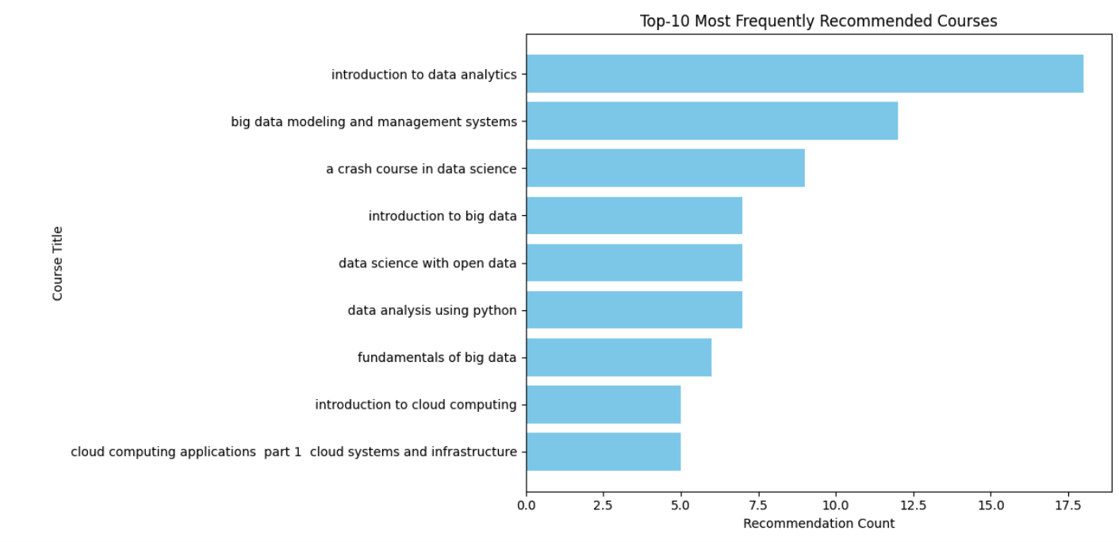
Hyperparameter Tuning Results (Similarity Threshold Impact)
Three similarity thresholds (0.2, 0.3, 0.4) were evaluated to understand their impact on recommendation quality.”
On average, how many new/unseen courses have been recommended per user (in the test user dataset):
5.0
Notes:
On average, users received 5 new courses — matching the Top‑5 recommendation setting, as none of the recommended courses overlapped with their existing enrollments.
This slide shows the hyperparameter tuning process for the content‑based recommender.
Three similarity thresholds were tested to balance recommendation diversity and precision.
Lower thresholds produce more recommendations but with lower precision.
Higher thresholds increase precision but reduce the number of new courses.
A threshold of 0.3 was selected as the optimal balance for this dataset.

Slide 20
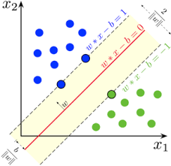
Collaborative-filtering Recommender System using Supervised Learning

Slide 21
Flowchart of KNN based recommender system
Raw data
User–course enrollment matrix
Course metadata (IDs, titles)
2.Data processing
Convert enrollment history into a user–item matrix
Handle sparsity (fill missing values with 0)
Normalize rows if needed (optional)
3.Feature Engineering
Represent each user as a vector of course enrollments
Compute pairwise user similarity (e.g., cosine similarity)
4.KNN Model
Select value of k (e.g., k = 5 or 10)
Identify the k nearest neighbors for the target user
Aggregate neighbor preferences
5.Generate recommendations
Predict unseen courses based on neighbor enrollments
Rank courses by predicted score
Filter out already‑enrolled courses
6.Output
Top‑N recommended courses displayed in the Streamlit UI
Notes:
This flowchart illustrates how the KNN‑based recommender system uses historical enrollment patterns to identify similar users and recommend courses they have taken.
After preprocessing the user–item matrix, the model computes similarity scores and selects the k nearest neighbors.
Their course histories are aggregated to predict which unseen courses the target user is most likely to enroll in.
The system then ranks and filters these predictions before returning the final Top‑N recommendations.
1. Raw Data >2.Data Processing>3.Feature Engineering>4.KNN Model>5.Generate recommendations>6.Output

Slide 22
Flowchart of NMF based recommender system
Raw data
User–course rating matrix
Course metadata (IDs, titles)
2.Data processing
Convert ratings into a sparse matrix
Normalize ratings (optional)
Handle missing values
3.Matrix factorization (NMF)
Apply Non‑Negative Matrix Factorization
Decompose user–item matrix into latent feature matrices
R \approx. P \cdot Q^T
Where P = user features, Q = item features
4.Prediction generation
Reconstruct predicted ratings from P \cdot Q^T
Identify top‑rated unseen courses for each user
Filter out already‑rated/enrolled courses
5.Output
Top‑N recommended courses
Displayed in the Streamlit UI
Notes:
This flowchart outlines the NMF‑based recommender system, which uses matrix factorization to uncover latent patterns in user–course interactions.
After preprocessing the rating matrix, the system applies Non‑Negative Matrix Factorization to decompose it into user and item feature matrices.
These are then multiplied to predict unseen ratings, which are ranked and filtered to generate personalized course recommendations.
1.Raw data>2.Data processing>3.Matrix factorization>4.Prediction generation>5.Output

Slide 23
Flowchart of Neural Network Embedding based recommender system
Raw data
User–course interaction history
Course metadata (IDs, titles, genres)
2.Data processing
Encode user and course IDs as categorical variables
Normalize and clean interaction data
Split into training and test sets
3.Feature Engineering
Create embedding layers for users and courses
Combine embeddings with additional features (e.g., genre vectors)
4.Neural network model
Input: user and course embeddings
Hidden layers: learn interaction patterns
Output: predicted rating or match score
5.Generate recommendations
Predict scores for unseen courses
Rank by predicted score
Filter out already‑interacted courses
6.Output
Top‑N recommended courses
Displayed in the Streamlit UI
Notes:
This flowchart outlines the neural network embedding‑based recommender system, which uses learned vector representations of users and courses to model complex interaction patterns.
After preprocessing and encoding the data, the system trains a neural network to predict match scores between users and courses.
These predictions are ranked and filtered to generate personalized recommendations.

Slide 24
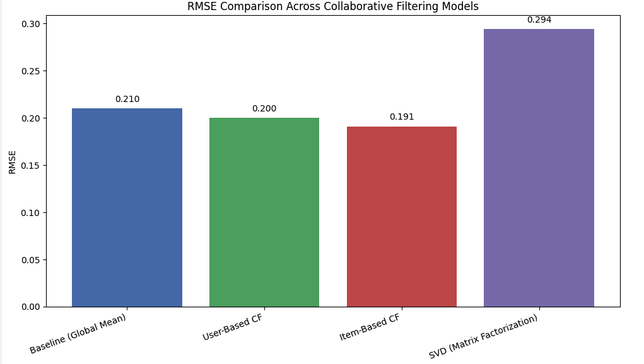
Compare the performance of collaborative-filtering models
Notes:
This bar chart compares the RMSE values of various collaborative filtering models.
Item‑based collaborative filtering achieves the lowest RMSE, indicating the strongest predictive accuracy. User‑based CF performs slightly worse, while SVD underperforms on this dataset, likely due to sparse user–item interactions.
The baseline model provides a reference point for improvement.

Slide 25
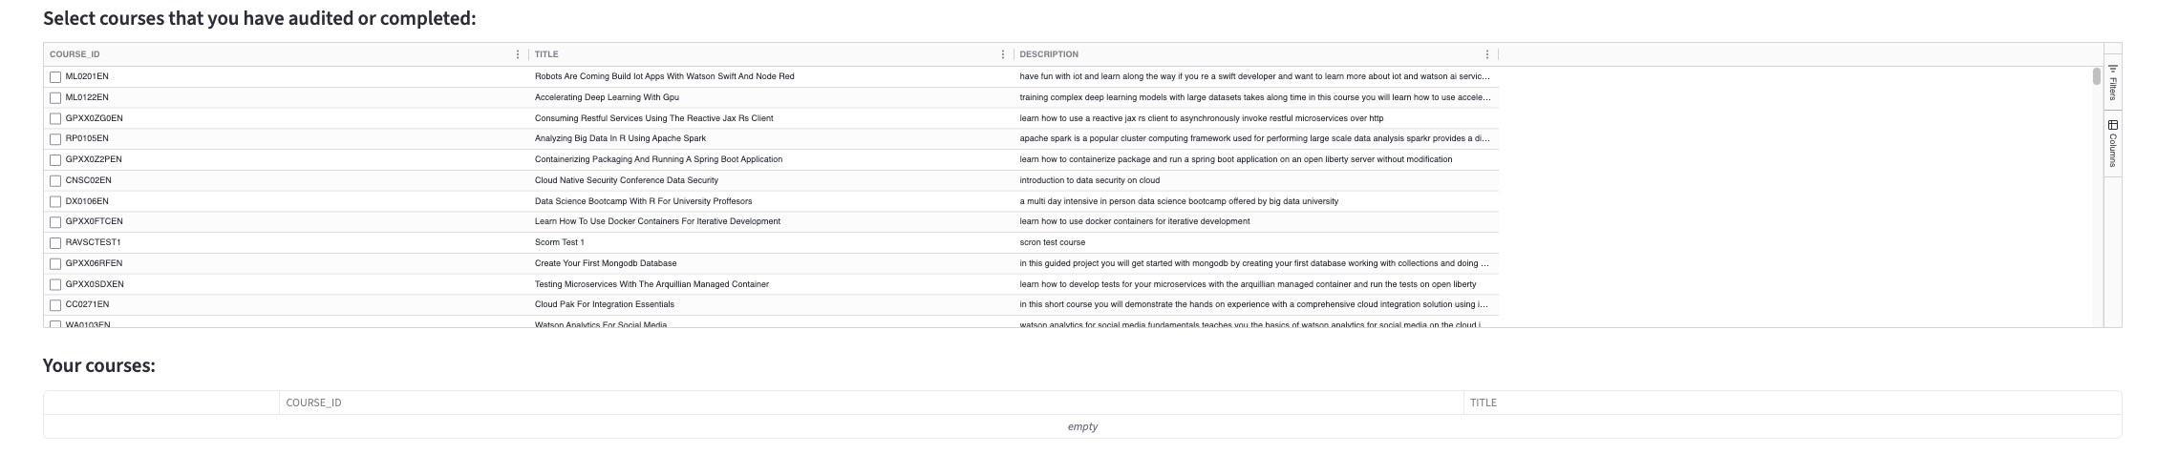
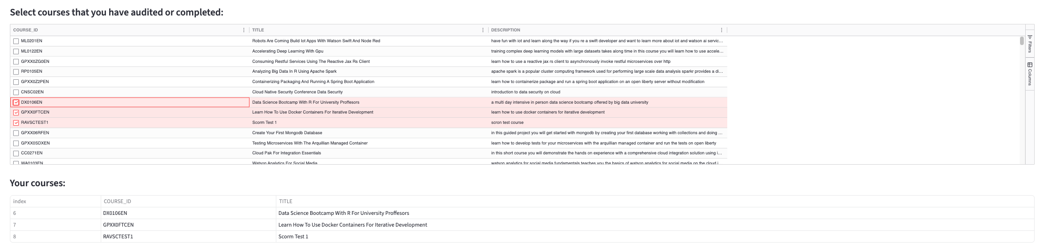
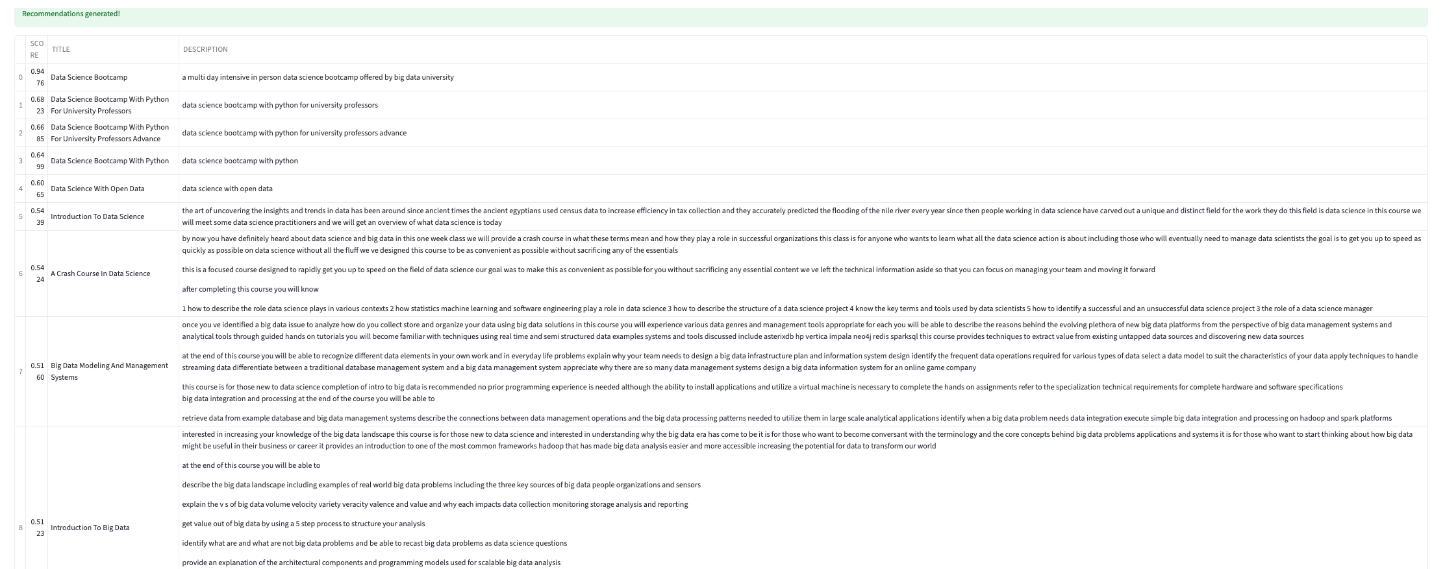
Build a course recommender system app with Streamlit
Streamlit app screenshot 1
Streamlit app screenshot 2
Streamlit app screenshot 3
Hyperlink:Published.
Notes:
The Streamlit app provides an interactive interface for generating personalized course recommendations.
Users can select courses, view similarity‑based suggestions, and explore dataset statistics.
These screenshots demonstrate the deployed UI and the model outputs.

Slide 26
Conclusions
Built a complete end‑to‑end recommender system using multiple ML approaches
Built a complete end‑to‑end recommender system using multiple ML approaches
Evaluated models using metrics such as RMSE, precision, recall, and new‑course coverage
Identified the best‑performing model based on empirical results
Deployed a working Streamlit app that delivers real‑time recommendations
Showed how data engineering, model design, and deployment form a coherent AI pipeline
Notes:
This project demonstrates the full lifecycle of an AI system, from raw data ingestion to model deployment. By implementing and evaluating multiple recommender system approaches, we highlighted the strengths and limitations of each method and selected the most effective models based on real performance metrics.
The final Streamlit app showcases how these models can be delivered as an interactive, user‑facing tool, completing the end‑to‑end machine learning pipeline.

Slide 27
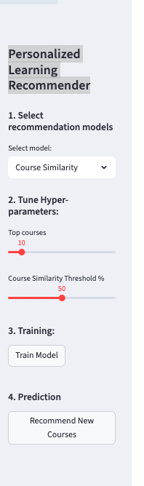
Appendix
Asset 1: Streamlit application link: http://localhost:8501
Asset 2: Streamlit control panel:
Asset 3 (code snippet – top courses):
def recommend_courses(user_id, model):
user_vector = model.transform(user_id)
scores = course_matrix.dot(user_vector.T)
top_courses = np.argsort(scores)[::-1][:10]
return course_df.iloc[top_courses]
Core recommendation logic: user vector transformed via model and matched against course matrix.
…
Notes:
3 assets listed: URL app, app screenshot and top courses code snippet.

